Slide 1
Dragons’ Reign
Jordon Kopp
Vince Smeraldo
Derek Finch
Matt Kalafut
Mark Muniz
Josh Kopp

Slide 2
Team Roles
Team Lead
Jordon Kopp
Lead Programmer
Vince Smeraldo
Programmers
Matt Kalafut
Mark Muniz
Derek Finch
Josh Kopp
Designer
Marco Malek
Out sourced artist

Slide 3
Scope/Purpose Statement
Scope
Standalone, functioning prototype
Top-down 2D fantasy RPG
Android platform
Purpose
Entertain
Mobile platform
Playable anywhere

Slide 4
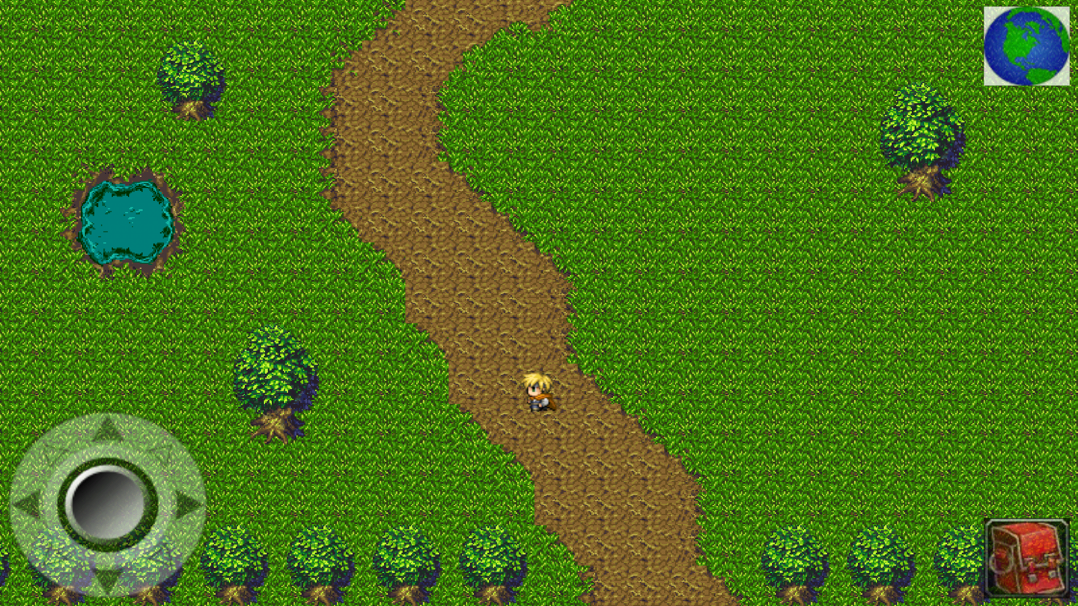
Player Screen/User Interface

Slide 5
Milestones
Finalized GDD (Game Design Document)
Finalized TDD (Technical Design Document)
Finished UI
Finished battle system
Finish character class
Finished playable zone
Finished major city
Finished completed game

Slide 6
Project Planning

Slide 7
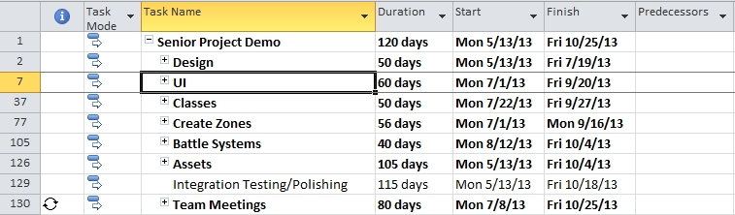
Project Planning

Slide 8
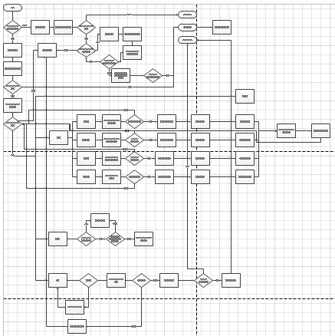
Project Planning: Battle System

Slide 9
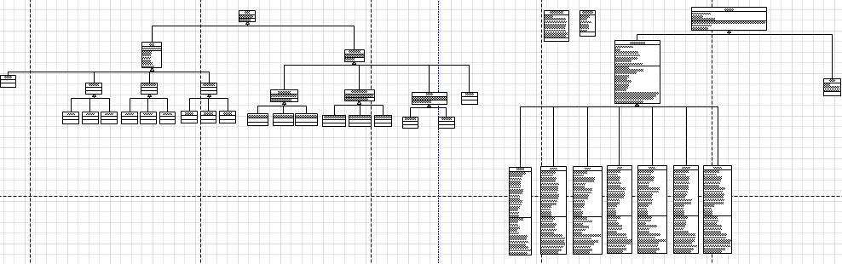
Project Planning: Character Class Diagrams

Slide 10
Development Environment
Android SDK
Java
Eclipse
Tiled
Tile Engine
TexturePacker
Creates Sprite Sheets
GitHub
Version Control
Online Repository
GIMP 2
Art Editing Tool

Slide 11
Assets
Art
Open-Source
Freelance Artist
Audio
Open-Source

Slide 12
Game Summary
Backstory
The world is unaware of the presence of dragons within their peaceful societies. Until that fateful day when dragons awakened, the world was never the same.
Story
Dragons have awakened in each of the regions and the local hostile tribes now worship them as Gods. It is the duty of the player to defeat the dragons in each of the regions, shattering the hostile tribes that worship them in the process. This eventually leads to defeating the Elder Dragon to rid the world of dragons forever.

Slide 13
Classes
Warrior
Melee
Heavy armor
One/two-handed
Axes/maces/swords
Ranger
Ranged
Medium armor
Bows
Shortbow/crossbow/longbow
Cleric
Support
Light armor
Wands/orbs/staves

Slide 14
Warrior Abilities
Basic Attack – single target
Cleave – multiple targets
Lunge – single target
Stun
Execute – single target
Damage based on resource depletion
Rend – single target
Bleed
War Cry – single target
Damage buff to party

Slide 15
Ranger Abilities
Basic Attack – single target
Fire Arrow – single target
Burn
Poison Arrow – single target
Poison
Spread Shot – multiple targets
Charged Shot – single target
Powerful single target
Stun Arrow – single target
Stun

Slide 16
Cleric Abilities
Basic Attack – single target
Mend – single target
Life Syphon – single target
Returns half health
Revive – single target
Resurrect fallen party member
Healing Chant – multiple targets
Heals entire party
Empower – multiple targets
Stats buff to party

Slide 17
Attributes
Strength
Increases physical damage
Dexterity
Increases physical damage
Physical critical strike chance
Vitality
Increases base health
Intelligence
Increases spell damage
Spell critical strike chance

Slide 18
Zones
Starter Village
Inn
Plains
Mountains

Slide 19
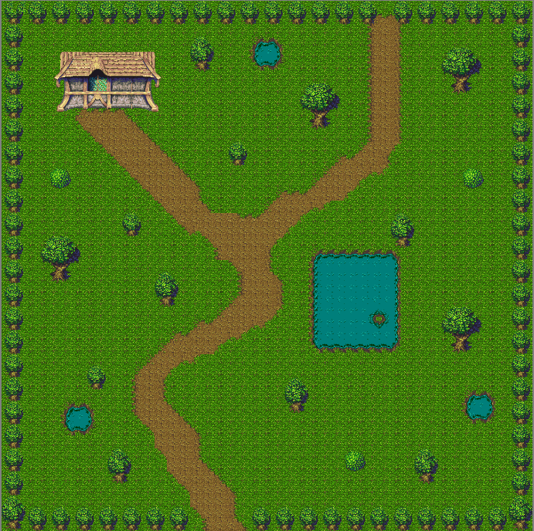
Starter Village

Slide 20
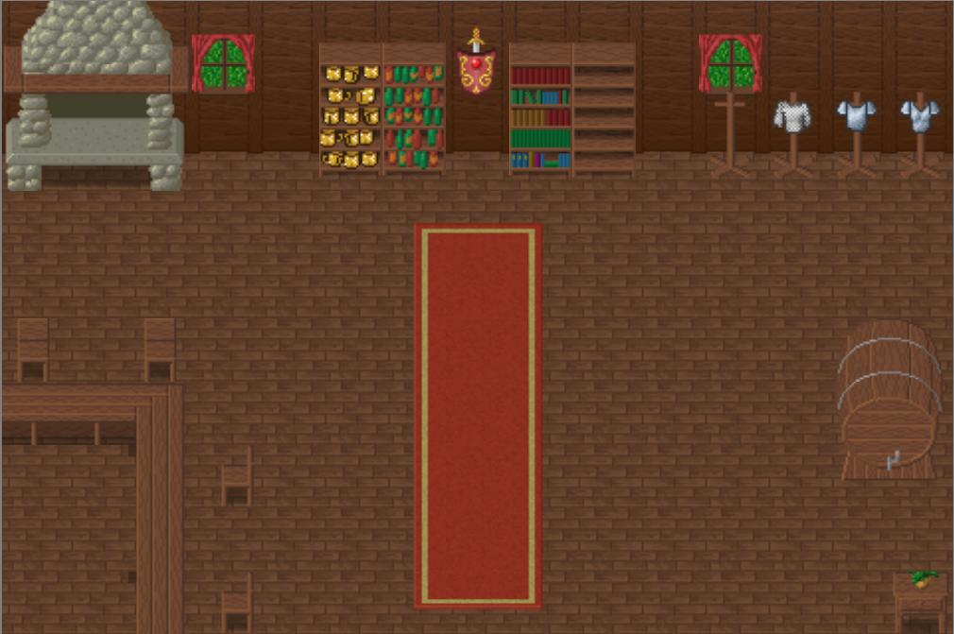
Inn

Slide 21
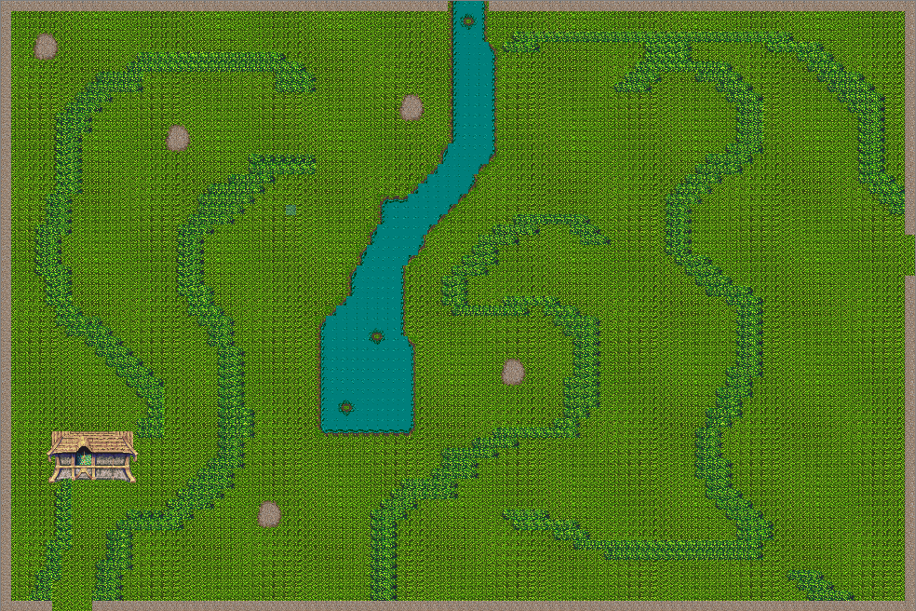
Plains

Slide 22
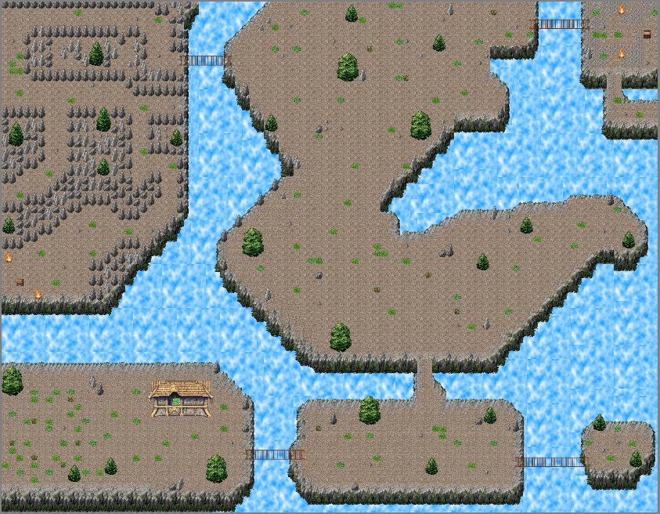
Mountains

Slide 23
Battle System

Slide 24
Battle System
Turn order based on internal haste value of the enemy
Each side takes turns
Continues until combat ends
Pop-up occurs at end of combat
Experience
Battle rations
Consumed on pickup
Health/resource gain
Does nothing if player has full health and full resource
Loot and inventory
Drag the desired items from loot box to inventory

Slide 25
Battle System
Battle effects
Blind – chance to miss – 2 turns
Daze – reduced damage – 2 turns
Poison – damage per turn – 2 turns
Burn – damage per turn – 2 turns
Chill – reduces defenses – 2 turns
Stun – blocks all attacks – 1 turn
Bleed – damage per turn – 2 turns

Slide 26
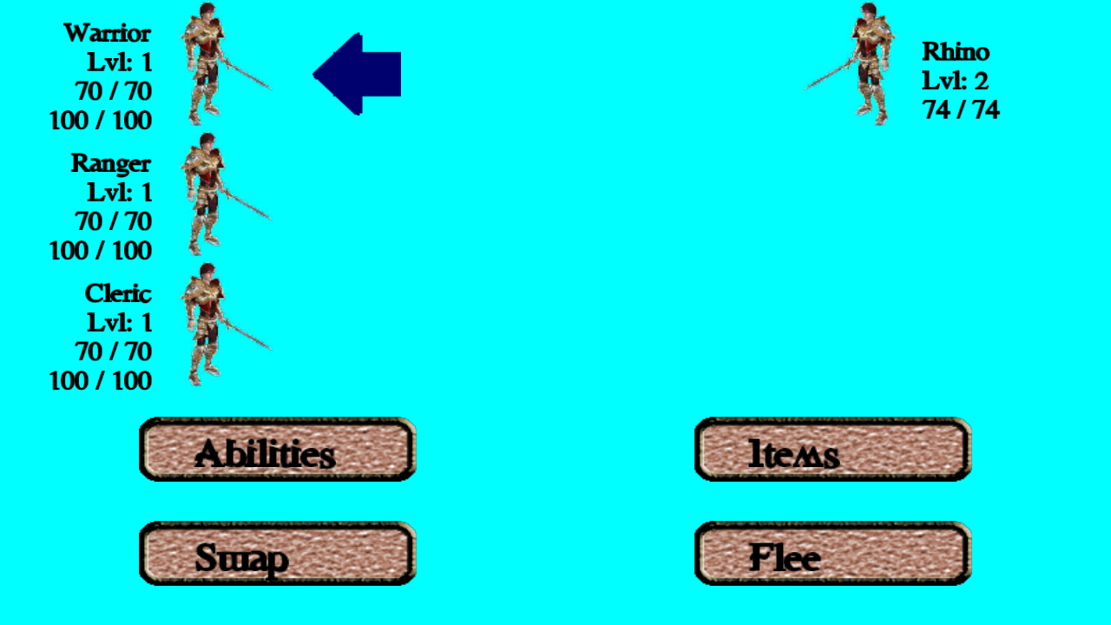
Battle System

Slide 27
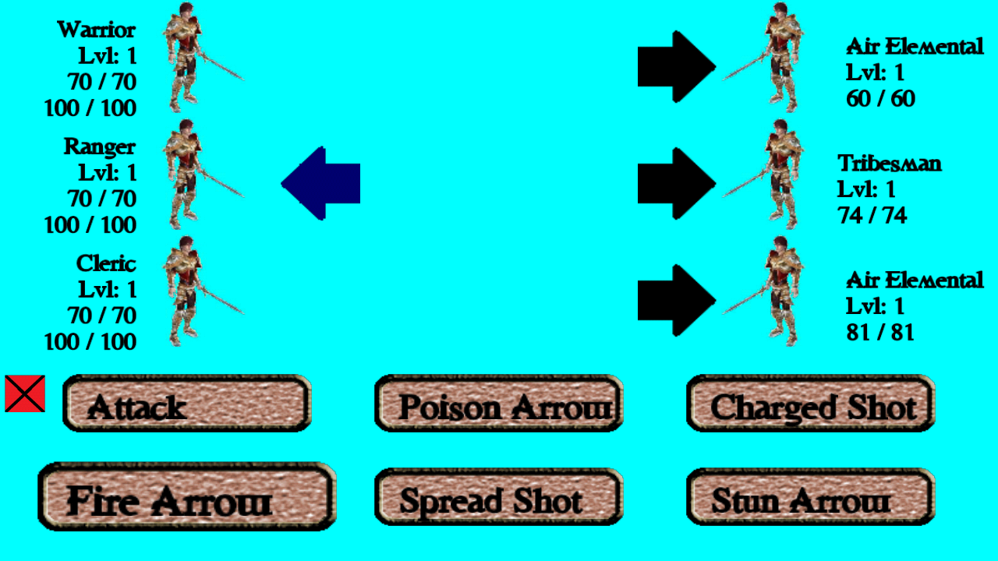
Battle System

Slide 28
Scope Cutbacks
Shop
Non-Playable Characters (NPCs) that generate a battle
Bosses
Treasure Chests
Quests
Challenges
Puzzles
Locked Doors
Cutscenes

Slide 29
Future
Classes
Assassin
Engineer
Mage
Knight
Zones
Caves
Desert
Tropics
Forest

Slide 30
Future
Fast Travel
Professions/crafting
Ally inventory
Persistent poison damage after battles
Micro-transactions
Currency
Diamonds
Allows instant access to content
Bundles
Remove ads

